Slide 1
EVENT HANDLING
DEPT OF CSE

Slide 2
Event handling is at the core of successful applet programming
There are several types of events
The most commonly handled events are those generated by the mouse, the keyboard, and various controls, such as a push button
Events are supported by the java.awt.event package
DEPT OF CSE

Slide 3
The Delegation Event Model
Defines standard and consistent mechanisms to generate and process events
A source generates an event and sends it to one or more listeners
The listener simply waits until it receives an event
Once received, the listener processes the event and then returns
DEPT OF CSE

Slide 4
The advantage of this design is that the application logic that processes events is cleanly separated from the user interface logic that generates those events
In the delegation event model, listeners must register with a source in order to receive an event notification
DEPT OF CSE

Slide 5
Events
In the delegation model, an event is an object that describes a state change in a source
It can be generated as a consequence of a person interacting with the elements in a graphical user interface
Some of the activities that cause events to be generated are pressing a button, entering a character via the keyboard, selecting an item in a list, and clicking the mouse
DEPT OF CSE

Slide 6
Event Sources
A source is an object that generates an event
Sources may generate more than one type of event
A source must register listeners in order for the listeners to receive notifications about a specific type of event
Each type of event has its own registration method.
The general form:
public void addTypeListener(TypeListener el)
Type is the name of the event and el is a reference to the event listener
DEPT OF CSE

Slide 7
A source must also provide a method that allows a listener to unregister an interest in a specific type of event
The general form of such a method is this:
public void removeTypeListener(TypeListener el)
Here, Type is the name of the event and el is a reference to the event listener
DEPT OF CSE

Slide 8
Event Listeners
A listener is an object that is notified when an event occurs
It has two major requirements
First, it must have been registered with one or more sources to receive notifications about specific types of events
Second, it must implement methods to receive and process these notifications
DEPT OF CSE

Slide 9
Event Classes
At the root of the Java event class hierarchy is EventObject, which is in java.util
It is the superclass for all events. Its one constructor is shown here:
EventObject(Object src)
Here, src is the object that generates this event
DEPT OF CSE

Slide 10
EventObject contains two methods: getSource( ) and toString( )
The getSource( ) method returns the source of the event
Object getSource()
toString( ) returns the string equivalent of the event
DEPT OF CSE

Slide 11
The class AWTEvent, defined within the java.awt package, is a subclass of EventObject
Its getID( ) method can be used to determine the type of the event
int getID()
DEPT OF CSE

Slide 12
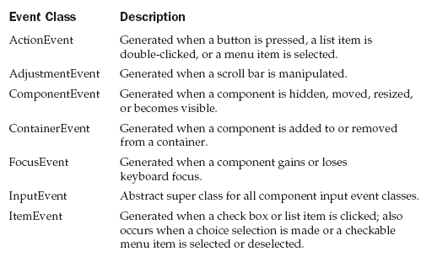
Main Event Classes in java.awt.event
DEPT OF CSE

Slide 13
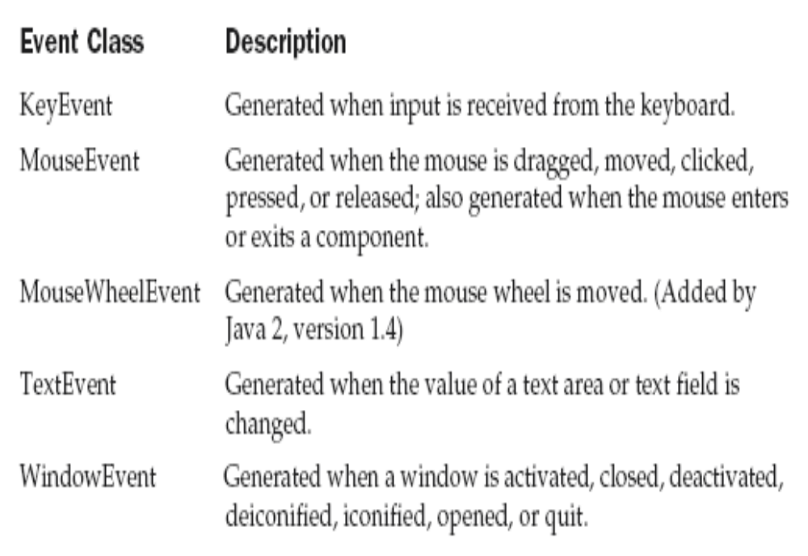
DEPT OF CSE

Slide 14
The ActionEvent Class
An ActionEvent is generated when a button is pressed, a list item is double-clicked, or a menu item is selected
The ActionEvent class defines four integer constants that can be used to identify any modifiers associated with an action event: ALT_MASK, CTRL_MASK, META_MASK, and SHIFT_MASK
In addition, there is an integer constant, ACTION_PERFORMED, which can be used to identify action events
DEPT OF CSE

Slide 15
ActionEvent has these three constructors:
ActionEvent(Object src, int type, String cmd)
ActionEvent(Object src, int type, String cmd, int modifiers)
ActionEvent(Object src, int type, String cmd, long when, int modifiers)
DEPT OF CSE

Slide 16
Here, src is a reference to the object that generated this event
The type of the event is specified by type, and its command string is cmd
The argument modifiers indicates which modifier keys (ALT, CTRL, META, and/or SHIFT) were pressed when the event was generated
The when parameter specifies when the event occurred
DEPT OF CSE

Slide 17
You can obtain the command name for the invoking ActionEvent object by using the getActionCommand( ) method, shown here:
String getActionCommand( )
For example, when a button is pressed, an action event is generated that has a command name equal to the label on that button
DEPT OF CSE

Slide 18
The AdjustmentEvent Class
An AdjustmentEvent is generated by a scroll bar
The AdjustmentEvent class defines integer constants that can be used to identify them
DEPT OF CSE

Slide 19
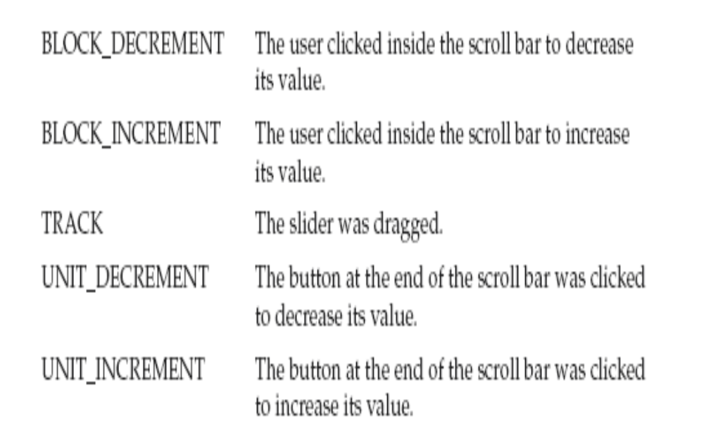
DEPT OF CSE

Slide 20
In addition, there is an integer constant, ADJUSTMENT_VALUE_CHANGED, that indicates that a change has occurred
The constructor:
AdjustmentEvent(Adjustable src, int id, int type, int data)
src is a reference to the object that generated this event
The id equals ADJUSTMENT_VALUE_CHANGED
The type of the event is specified by type, and its associated data is data
DEPT OF CSE

Slide 21
The getAdjustable( ) method returns the object that generated the event
The type of the adjustment event may be obtained by the getAdjustmentType( ) method
DEPT OF CSE

Slide 22
The ComponentEvent Class
A ComponentEvent is generated when the size, position, or visibility of a component is changed
There are four types of component events
The ComponentEvent class defines integer constants that can be used to identify them
DEPT OF CSE

Slide 23
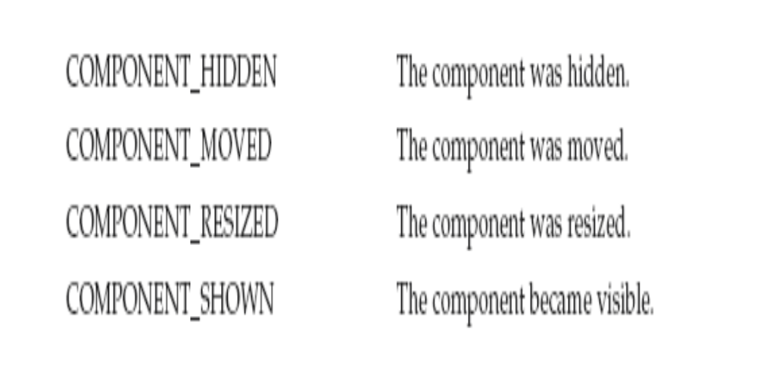
DEPT OF CSE

Slide 24
ComponentEvent(Component src, int type)
src is a reference to the object that generated this event
The type of the event is specified by type
The getComponent( ) method returns the component that generated the event
DEPT OF CSE

Slide 25
The ContainerEvent Class
A ContainerEvent is generated when a component is added to or removed from a container
The ContainerEvent class defines int constants that can be used to identify them: COMPONENT_ADDED and COMPONENT_REMOVED
DEPT OF CSE

Slide 26
ContainerEvent is a subclass of
ComponentEvent and has this constructor:
ContainerEvent(Component src, int type, Component comp)
src is a reference to the container that generated this event
The type of the event is specified by type and the component that has been added to or removed from the container is comp
You can obtain a reference to the container that generated this event by using the getContainer( ) method
DEPT OF CSE

Slide 27
The FocusEvent Class
A FocusEvent is generated when a component gains or loses input focus
These events are identified by the integer constants FOCUS_GAINED and FOCUS_LOST
FocusEvent is a subclass of ComponentEvent and has these constructors:
FocusEvent(Component src, int type)
FocusEvent(Component src, int type, boolean temporaryFlag)
Focus Event(Component src, int type, boolean temporaryFlag, Component other)
DEPT OF CSE

Slide 28
src is a reference to the component that generated this event
The type of the event is specified by type
The argument temporaryFlag is set to true if the focus event is temporary; Otherwise, it is set to false
If a FOCUS_GAINED event occurred, other will refer to the component that lost focus
Conversely, if a FOCUS_LOST event occurred, other will refer to the component that gains focus
DEPT OF CSE

Slide 29
The InputEvent Class
The abstract class InputEvent is a subclass of ComponentEvent and is the superclass for component input events
Its subclasses are KeyEvent and MouseEvent
boolean isAltDown( )
boolean isAltGraphDown( )
boolean isControlDown( )
boolean isMetaDown( )
boolean isShiftDown( )
DEPT OF CSE

Slide 30
The ItemEvent Class
An ItemEvent is generated when a check box or a list item is clicked or when a checkable menu item is selected or deselected
There are two types of item events, which are identified by the following integer constants:
DESELECTED The user deselected an item.
SELECTED The user selected an item.
DEPT OF CSE

Slide 31
ItemEvent has this constructor:
ItemEvent(ItemSelectable src, int type, Object entry, int state)
src is a reference to the component that generated this event
The type of the event is specified by type
The specific item that generated the item event is passed in entry
The current state of that item is in state
DEPT OF CSE

Slide 32
The KeyEvent Class
A KeyEvent is generated when keyboard input occurs
There are three types of key events, which are identified by these integer constants: KEY_PRESSED, KEY_RELEASED, and KEY_TYPED
The first two events are generated when any key is pressed or released
The last event occurs only when a character is generated
For example, pressing the SHIFT key does not generate a character
DEPT OF CSE

Slide 33
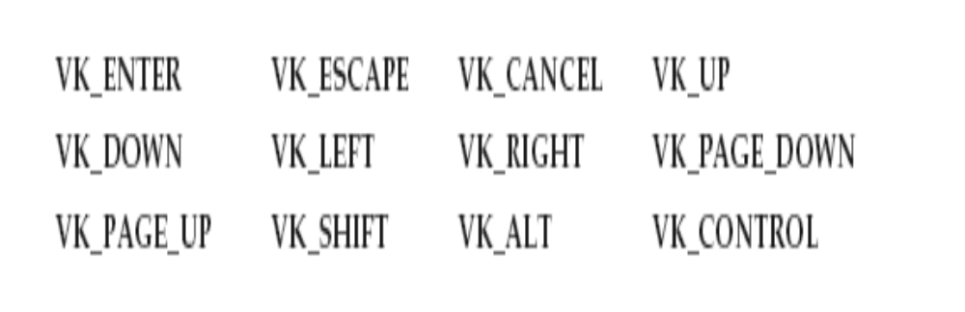
There are many other integer constants that are defined by KeyEvent
VK_0 through VK_9 and VK_A through VK_Z define the ASCII equivalents of the numbers and letters
DEPT OF CSE

Slide 34
KeyEvent is a subclass of InputEvent. Here are two of its constructors:
KeyEvent(Component src, int type, long when, int modifiers, int code)
KeyEvent(Component src, int type, long when, int modifiers, int code, char ch)
src is a reference to the component that generated the event
The type of the event is specified by type
The system time at which the key was pressed is passed in when
The modifiers argument indicates which modifiers were pressed when this key event occurred
The virtual key code, such as VK_UP, VK_A, and so forth, is passed in code
DEPT OF CSE

Slide 35
The character equivalent (if one exists) is passed in ch
If no valid character exists, then ch contains CHAR_UNDEFINED
For KEY_TYPED events, code will contain VK_UNDEFINED
DEPT OF CSE

Slide 36
The MouseEvent Class
There are eight types of mouse events
MouseEvent is a subclass of InputEvent.
The MouseEvent class defines the following integer constants that can be used to identify them:
DEPT OF CSE

Slide 37
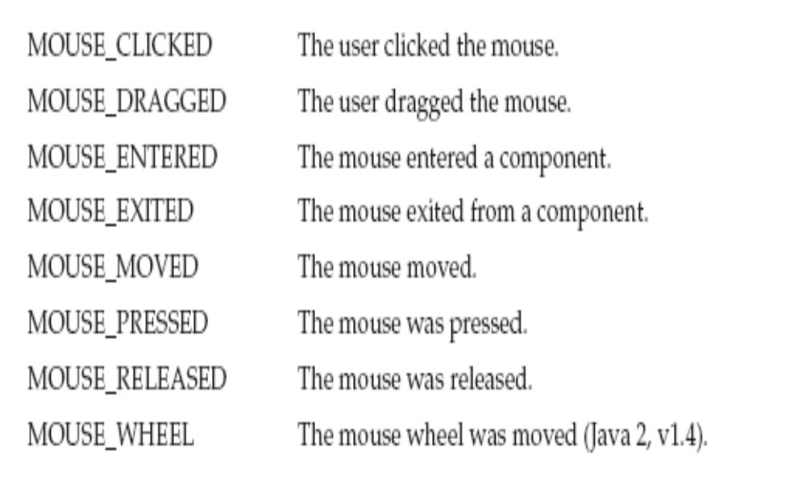
DEPT OF CSE

Slide 38
MouseEvent(Component src, int type, long when, int modifiers, int x, int y, int clicks, boolean triggersPopup)
The modifiers argument indicates which modifiers were pressed when a mouse event occurred
The coordinates of the mouse are passed in x and y. The click count is passed in clicks
The triggersPopup flag indicates if this event causes a pop-up menu to appear on this platform
DEPT OF CSE

Slide 39
The TextEvent Class
Instances of this class describe text events
These are generated by text fields and text areas when characters are entered by a user or program
TextEvent defines the integer constant TEXT_VALUE_CHANGED
The one constructor for this class is shown here:
TextEvent(Object src, int type)
src is a reference to the object that generated this event, type of the event is specified by type
DEPT OF CSE

Slide 40
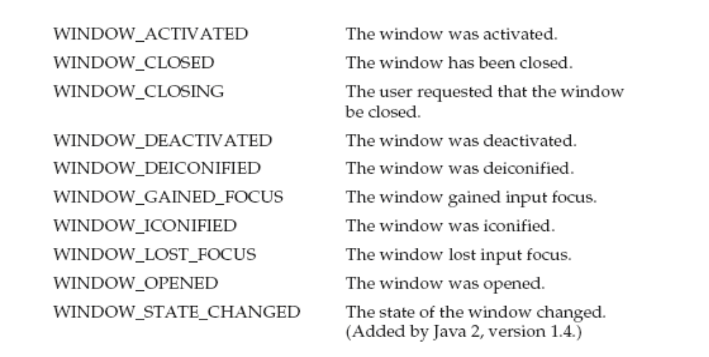
The WindowEvent Class
The WindowEvent class defines integer constants that can be used to identify them
DEPT OF CSE

Slide 41
WindowEvent is a subclass of ComponentEvent. It defines several constructors.The first is
WindowEvent(Window src, int type)
src is a reference to the object that generated this event
The type of the event is type
DEPT OF CSE

Slide 42
WindowEvent(Window src, int type, Window other)
WindowEvent(Window src, int type, int fromState, int toState)
WindowEvent(Window src, int type, Window other, int fromState, int toState)
DEPT OF CSE

Slide 43
other specifies the opposite window when a focus event occurs
The fromState specifies the prior state of the window and toState specifies the new state that the window will have when a window state change occurs
DEPT OF CSE

Slide 44
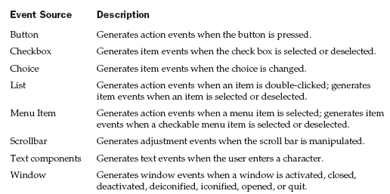
Sources of Events
DEPT OF CSE

Slide 45
Event Listener Interfaces
Listeners are created by implementing one or more of the interfaces defined by the java.awt.event package
When an event occurs, the event source invokes the appropriate method defined by the listener and provides an event object as its argument
DEPT OF CSE

Slide 46
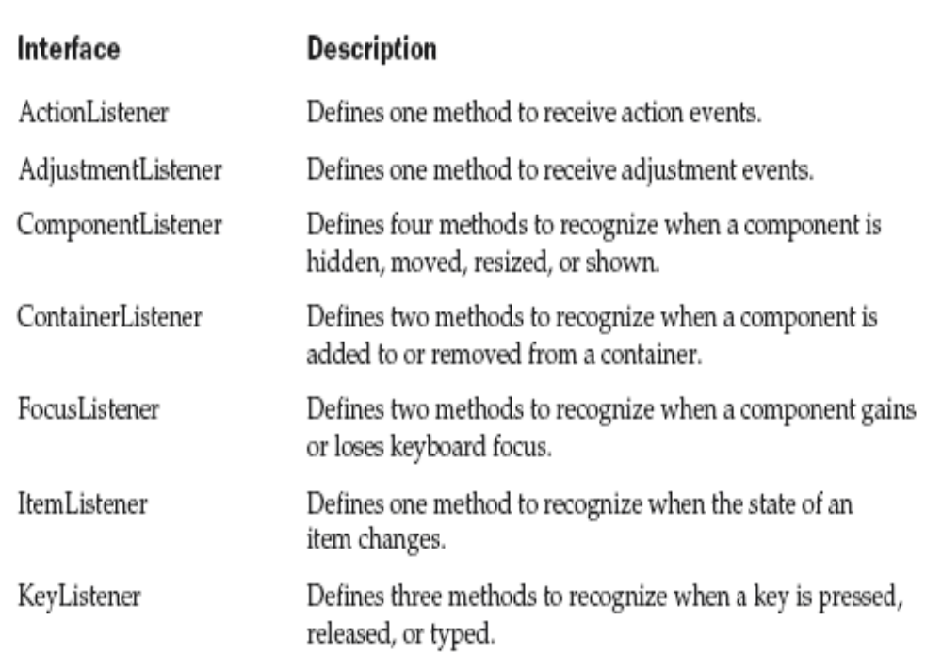
DEPT OF CSE

Slide 47
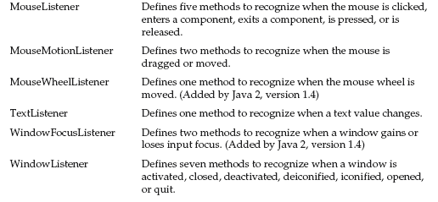
DEPT OF CSE

Slide 48
The ActionListener Interface
This interface defines the actionPerformed( ) method that is invoked when an action event occurs. Its general form is shown here:
void actionPerformed(ActionEvent ae)
DEPT OF CSE

Slide 49
The FocusListener Interface
This interface defines two methods
When a component obtains keyboard focus, focusGained( ) is invoked
When a component loses keyboard focus, focusLost( ) is called
Their general forms are shown here:
void focusGained(FocusEvent fe)
void focusLost(FocusEvent fe)
DEPT OF CSE

Slide 50
The KeyListener Interface
This interface defines three methods
The keyPressed( ) and keyReleased( ) methods are invoked when a key is pressed and released, respectively
The keyTyped( ) method is invoked when a character has been entered
DEPT OF CSE

Slide 51
if a user presses and releases the A key, three events are generated in sequence: key pressed, typed, and released
If a user presses and releases the HOME key, two key events are generated in sequence: key pressed and released
The general forms of these methods are shown here:
void keyPressed(KeyEvent ke)
void keyReleased(KeyEvent ke)
void keyTyped(KeyEvent ke)
DEPT OF CSE

Slide 52
The MouseListener Interface
This interface defines five methods
void mouseClicked(MouseEvent me)
void mouseEntered(MouseEvent me)
void mouseExited(MouseEvent me)
void mousePressed(MouseEvent me)
void mouseReleased(MouseEvent me)
DEPT OF CSE

Slide 53
The MouseMotionListener Interface
void mouseDragged(MouseEvent me)
void mouseMoved(MouseEvent me)
DEPT OF CSE

Slide 54
The TextListener Interface
Defines the textChanged( ) method that is invoked when a change occurs in a text area or text field
void textChanged(TextEvent te)
DEPT OF CSE

Slide 55
The WindowFocusListener Interface
defines two methods:
windowGainedFocus( ) and windowLostFocus( )
These are called when a window gains or losses input focus
void windowGainedFocus(WindowEvent we)
void windowLostFocus(WindowEvent we)
DEPT OF CSE

Slide 56
The WindowListener Interface
void windowActivated(WindowEvent we)
void windowClosed(WindowEvent we)
void windowClosing(WindowEvent we)
void windowDeactivated(WindowEvent we)
void windowDeiconified(WindowEvent we)
void windowIconified(WindowEvent we)
void windowOpened(WindowEvent we)
DEPT OF CSE

Slide 57
Handling Mouse Events ExMouse.java
// Demonstrate the mouse event handlers.
import java.awt.*;
import java.awt.event.*;
import java.applet.*;
/*
<applet code="MouseEvents" width=300 height=100>
</applet>
*/
DEPT OF CSE

Slide 58
public class MouseEvents extends Applet
implements MouseListener, MouseMotionListener {
String msg = "";
int mouseX = 0, mouseY = 0; // coordinates of mouse
public void init() {
addMouseListener(this); //Registration
addMouseMotionListener(this);//Registration
}
public void mouseClicked(MouseEvent me) {
// save coordinates
mouseX = 0;
mouseY = 10;
msg = "Mouse clicked.";
repaint();
}
// Handle mouse entered.
public void mouseEntered(MouseEvent me) {
// save coordinates
mouseX = 0;
mouseY = 10;
msg = "Mouse entered.";
repaint();
}
DEPT OF CSE

Slide 59
public void mouseExited(MouseEvent me) {
// save coordinates
mouseX = 0;
mouseY = 10;
msg = "Mouse exited.";
repaint();
}
public void mousePressed(MouseEvent me) {
// save coordinates
mouseX = me.getX();
mouseY = me.getY();
msg = "Down";
repaint();
}
public void mouseReleased(MouseEvent me) {
// save coordinates
mouseX = me.getX();
mouseY = me.getY();
msg = "Up";
repaint();
}
DEPT OF CSE

Slide 60
public void mouseDragged(MouseEvent me) {
// save coordinates
mouseX = me.getX();
mouseY = me.getY();
msg = "*";
showStatus("Dragging mouse at " + mouseX + ", " + mouseY);
repaint();
}
// Handle mouse moved.
public void mouseMoved(MouseEvent me) {
// show status
showStatus("Moving mouse at " + me.getX() + ", " + me.getY());
}
// Display msg in applet window at current X,Y location.
public void paint(Graphics g) {
g.drawString(msg, mouseX, mouseY);
}
}
DEPT OF CSE

Slide 61
Handling Keyboard Events simplekey.java
// Demonstrate the key event handlers.
import java.awt.*;
import java.awt.event.*;
import java.applet.*;
/*
<applet code="SimpleKey" width=300 height=100>
</applet>
*/
public class SimpleKey extends Applet
implements KeyListener {
String msg = "";
int X = 10, Y = 20; // output coordinates
public void init() {
addKeyListener(this);
requestFocus(); // request input focus
}
public void keyPressed(KeyEvent ke) {
showStatus("Key Down");
}
DEPT OF CSE

Slide 62
public void keyReleased(KeyEvent ke) {
showStatus("Key Up");
}
public void keyTyped(KeyEvent ke) {
msg += ke.getKeyChar();
repaint();
}
// Display keystrokes.
public void paint(Graphics g) {
g.drawString(msg, X, Y);
}
}
DEPT OF CSE

Slide 63
// Demonstrate some virtual key codes. Keyevents.java
import java.awt.*;
import java.awt.event.*;
import java.applet.*;
/*
<applet code="KeyEvents" width=300 height=100>
</applet>
*/
public class KeyEvents extends Applet
implements KeyListener {
String msg = "";
int X = 10, Y = 20; // output coordinates
public void init() {
addKeyListener(this);
requestFocus(); // request input focus
}
DEPT OF CSE

Slide 64
public void keyPressed(KeyEvent ke) {
showStatus("Key Down");
int key = ke.getKeyCode();
switch(key) {
case KeyEvent.VK_F1:
msg += "<F1>";
break;
case KeyEvent.VK_F2:
msg += "<F2>";
break;
case KeyEvent.VK_F3:
msg += "<F3>";
break;
DEPT OF CSE

Slide 65
case KeyEvent.VK_PAGE_DOWN:
msg += "<PgDn>";
break;
case KeyEvent.VK_PAGE_UP:
msg += "<PgUp>";
break;
case KeyEvent.VK_LEFT:
msg += "<Left Arrow>";
break;
case KeyEvent.VK_RIGHT:
msg += "<Right Arrow>";
break;
}
repaint();
}
DEPT OF CSE

Slide 66
public void keyReleased(KeyEvent ke) {
showStatus("Key Up");
}
public void keyTyped(KeyEvent ke) {
msg += ke.getKeyChar();
repaint();
}
// Display keystrokes.
public void paint(Graphics g) {
g.drawString(msg, X, Y);
}
}
DEPT OF CSE

Slide 67
Adapter Classes
These are classes provided by java to simplify the event handling.
These give default implementations to the methods in each listener interfaces such that whenever programmer needs to override only a few listener interface methods, giving blank implementations to the rest member methods can be avoided.
DEPT OF CSE

Slide 68
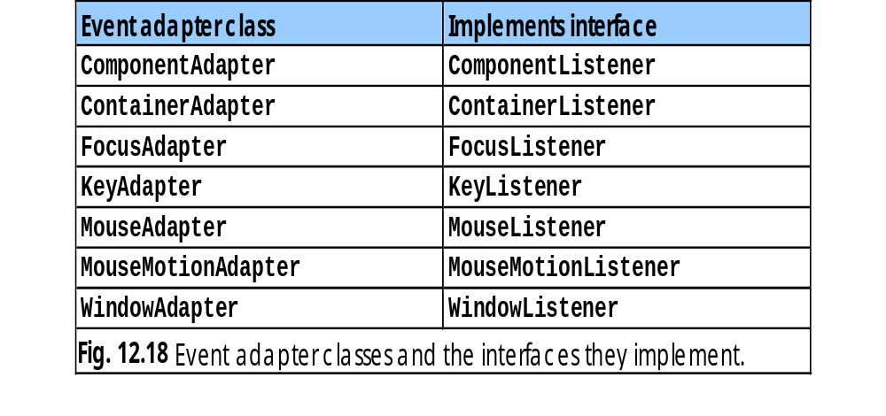
List of such adapters are
DEPT OF CSE

Slide 69
Using Adapter Classes
listing 4
// Demonstrate an adaptor.
import java.awt.*;
import java.awt.event.*;
import java.applet.*;
/*
<applet code="AdapterDemo" width=300 height=100>
</applet>
DEPT OF CSE

Slide 70
Using Adapter Classes
*/
public class AdapterDemo extends Applet {
public void init() {
addMouseListener(new MyMouseAdapter(this));
addMouseMotionListener(new MyMouseMotionAdapter(this));
}
}
class MyMouseAdapter extends MouseAdapter {
AdapterDemo adapterDemo;
DEPT OF CSE

Slide 71
Using Adapter Classes
public MyMouseAdapter(AdapterDemo adapterDemo) {
this.adapterDemo = adapterDemo;
}
// Handle mouse clicked.
public void mouseClicked(MouseEvent me) {
adapterDemo.showStatus("Mouse clicked");
}
}
class MyMouseMotionAdapter extends MouseMotionAdapter {
DEPT OF CSE

Slide 72
Using Adapter Classes
AdapterDemo adapterDemo;
public MyMouseMotionAdapter(AdapterDemo adapterDemo) {
this.adapterDemo = adapterDemo;
}
// Handle mouse dragged.
public void mouseDragged(MouseEvent me) {
adapterDemo.showStatus("Mouse dragged");
}
}
DEPT OF CSE

Slide 73
Using InnerClasses for Event Handling
An inner class is a class defined inside another class or within an expression.
This section shows us the benefit of above class in event handling
Example usage as follows
DEPT OF CSE

Slide 74
Inner class usage
Ex: wihout inner class
listing 5
// This applet does NOT use an inner class.
import java.applet.*;
import java.awt.event.*;
/*
<applet code="MousePressedDemo" width=200 height=100>
</applet>
*/
public class MousePressedDemo extends Applet {
public void init() {
DEPT OF CSE

Slide 75
Inner class usage
Ex: wihout inner class
addMouseListener(new MyMouseAdapter(this));
}
}
class MyMouseAdapter extends MouseAdapter {
MousePressedDemo mousePressedDemo;
public MyMouseAdapter(MousePressedDemo mousePressedDemo) {
this.mousePressedDemo = mousePressedDemo;
}
public void mousePressed(MouseEvent me) {
mousePressedDemo.showStatus("Mouse Pressed.");
}
}
DEPT OF CSE

Slide 76
Inner Class Usage
Ex:With Inner class
listing 6
// Inner class demo
import java.applet.*;
import java.awt.event.*;
public class InnerClassDemo extends Applet {
public void init() {
addMouseListener(new MyMouseAdapter());
}
class MyMouseAdapter extends MouseAdapter {
public void mousePressed(MouseEvent me) {
showStatus("Mouse Pressed");
}
}
}
DEPT OF CSE

Slide 77
Anonymous Inner classes that extends MouseAdapter
Inner classes without name
listing 7
// Anonymous inner class demo.
import java.applet.*;
import java.awt.event.*;
public class AnonymousInnerClassDemo extends Applet {
public void init() {
addMouseListener(new MouseAdapter() {
public void mousePressed(MouseEvent me) {
showStatus("Mouse Pressed");
}
});
}
}
DEPT OF CSE

